Slide 1

Module 5 Project Regression Analysis and Descriptive Statistics for Sales of Car in India (1998-2019)
ALY 6010 Prob Theory and Intro Stats
SEC 03 CRN 20698
Dr. Dee Chiluiza, PhD
Ayas Rashmi B
NUID:
Shah Dhruvin Rakesh
NUID: 001087062

Slide 2

Introduction and Methodology
In statistics, correlation and regression analysis is used to collect data from two different samples and then applying checks on the two variables to confirm if a relationship exists between the dependent and the independent variable.
The given data of Car Sales in India is analyzed. The attributes like Owner Type, Fuel Type, Efficiency, Power, Engine, No of Seats, Transmission as well as price were extracted and processed to retrieve vital information for calculating Efficiency and price and categorizing it according to Owner Type, Number of Seats, Fuel Type and Transmission.
Data Processing was done using R Programming in R Studio and various graphs like correlation and regression were generated to easily interpret the data. The tables were amended in Microsoft Excel.
Correlation was done to fetch the best possible solution.

Slide 3
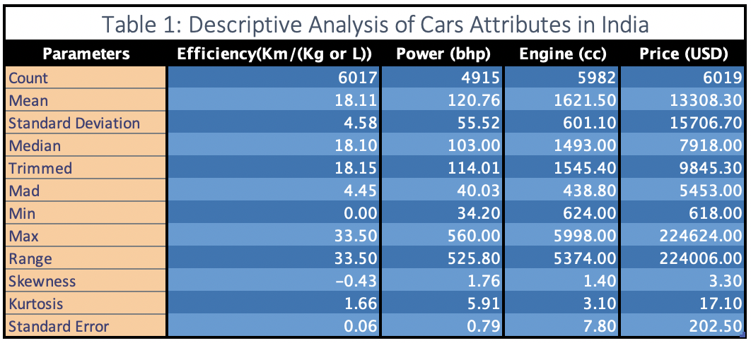
Descriptive Analysis of Population Data
From Table 1, it is observed that the most efficient car has efficiency of 33.50 and the costliest car has price 224624 USD.
The average car has the 18.11 km/(kg or L) efficiency, 120.76 bhp Power, 1621.50 cc with average price of 13308.30 USD.

Slide 4
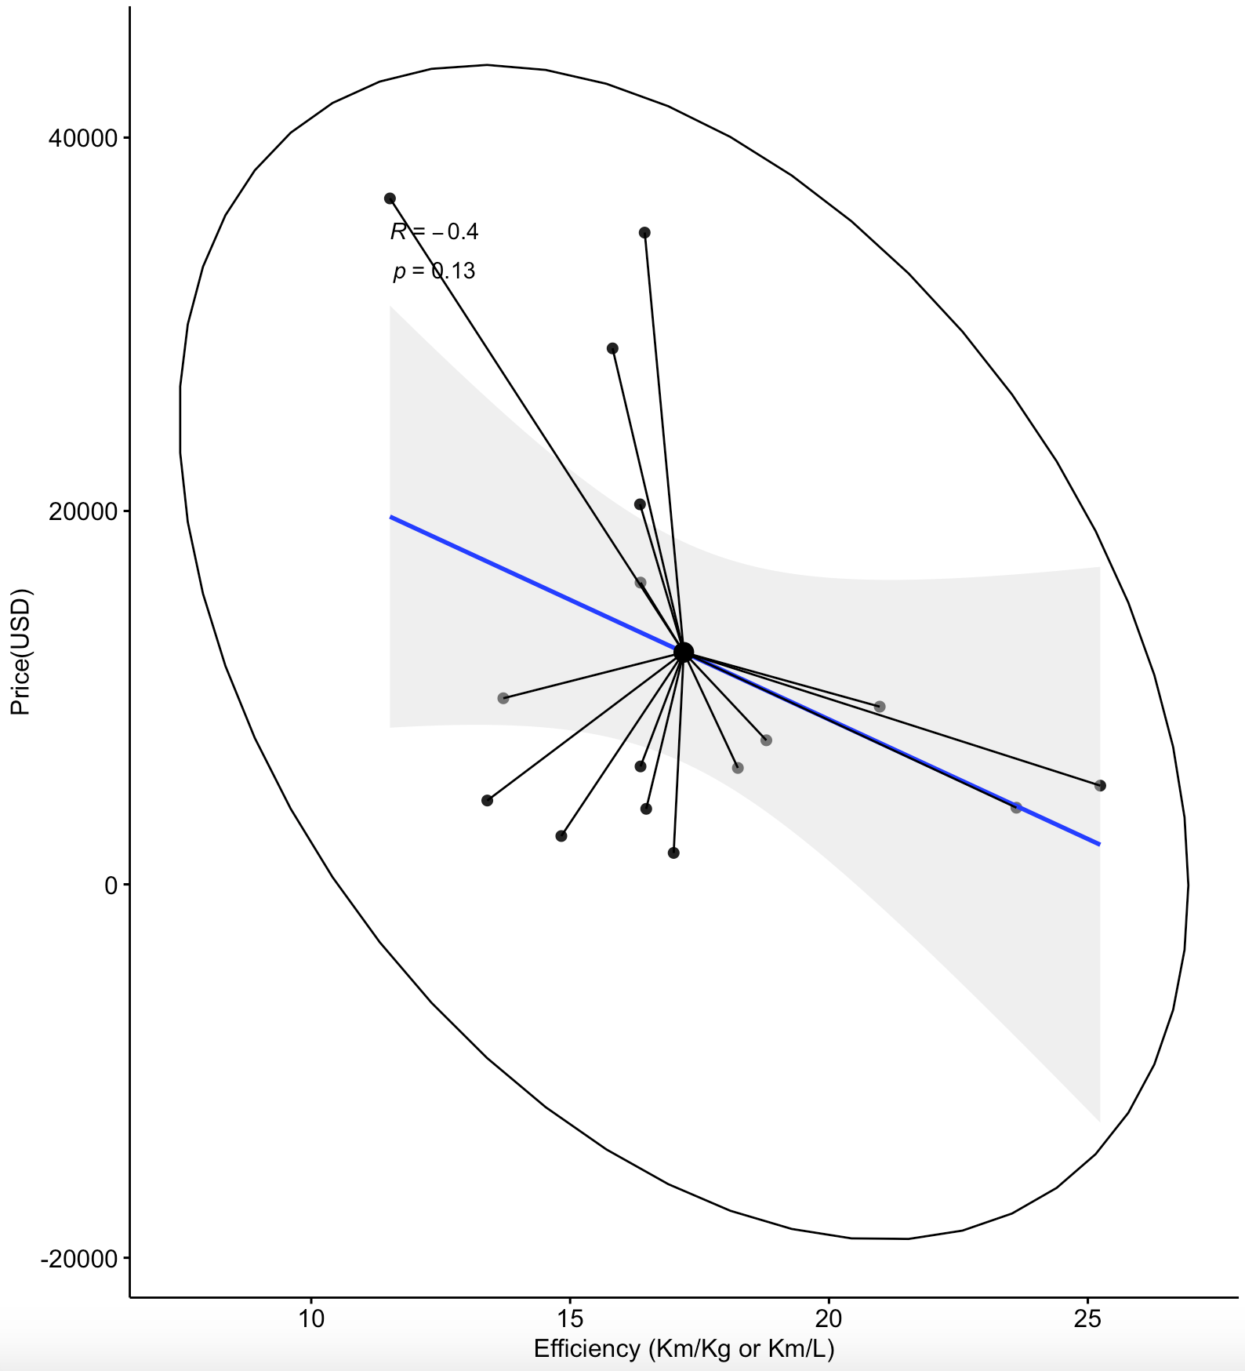
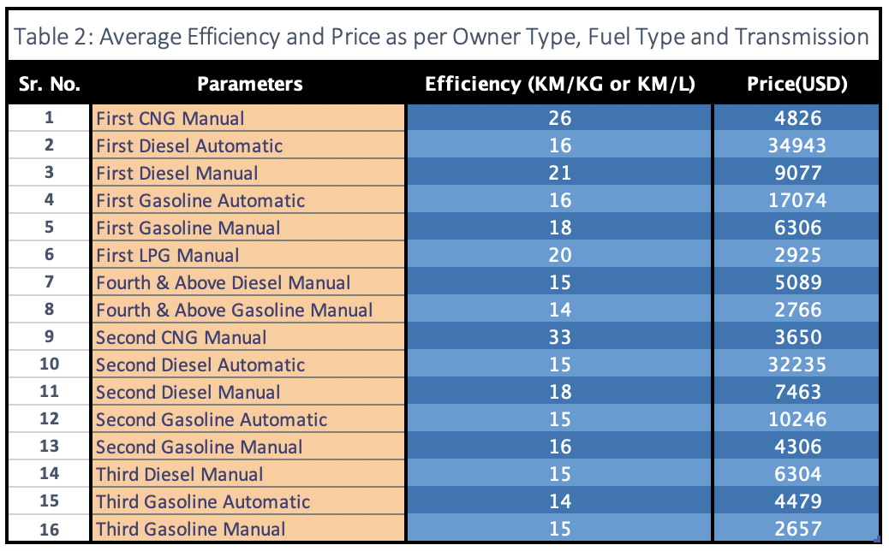
Inferential Statistics
Figure 1: Scatter Plot of Correlation between Price and Efficiency with respect to Owner Type, Fuel Type and Transmission
The linear (Pearson Product Moment) correlation coefficient computed from the sample data measures the strength and direction of a linear relationship between two quantitative variables. The symbol for the sample correlation coefficient is r (Bluman, 2018) .
The eclipse plots maximum area can be covered by Scattering whereas Star plots the distance of each point from mean point.
Blue line depicts the line of regression using Pearson method with R= -0.4 and p=0.13.
From Table 2, it is observed that First Owner Type CNG car with manual transmission is the most effective choice in terms of average efficiency and cost.
From Figure 1 it can be depicted that as Price Increases, Efficiency of car decreases and vice-versa.

Slide 5
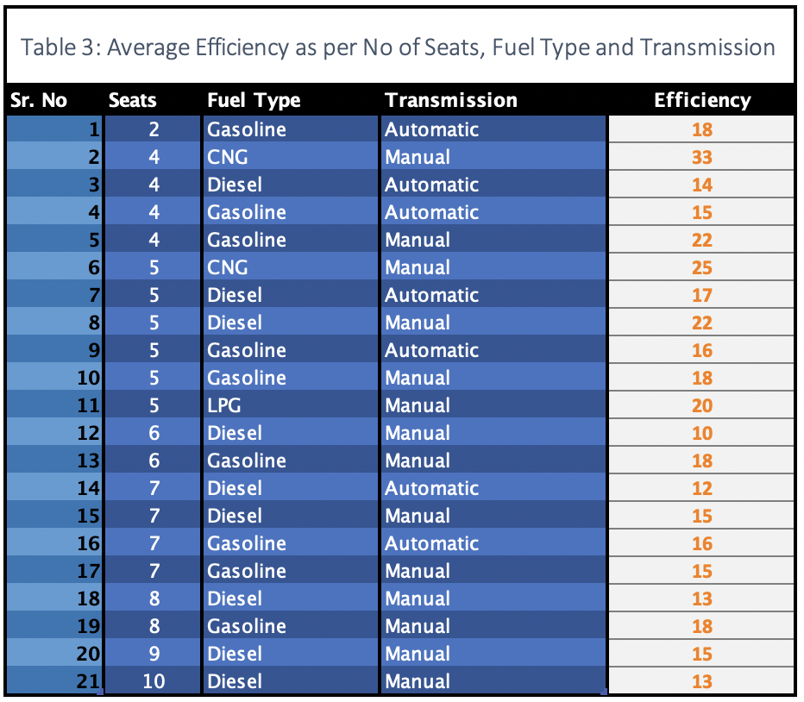
Inferential Statistics
From Table 3, it can be derived that the Highest average Efficiency: 33 kg/L is for 4 seats car running on CNG Fuel with Manual Transmission in India.
Maximum number of passengers accommodate is by 10 Seat Diesel Car.
The Fuel Type option of CNG and LPG are not available for cars more than 5 seats and only Manual transmission is available for cars more than 8 seats.
Cars in India have less Automatic Transmission options as compared to Manual Transmission.
Most options are available in car having 5 Seats in India.
The Efficiency of Diesel cars in India are less compared to other Fuel options.

Slide 6
Decision Making
If customer has to travel more distance than he should opt for Second Owner Type car with CNG Fuel Type and Manual Transmission.
If a customer wants to buy a Small Family car then he should opt for First Owner Type LPG Manual or First Owner Type CNG Manual.
If customer wants to buy Small Automatic car then he should go for Gasoline Fuel Type.
If customer requires more capacity cars than he should opt for Gasoline or Diesel Fuel Type cars with Manual Transmission.

Slide 7

Conclusion
Due to long travel, people in India prefer CNG or LPG Fuel as it reduces the cost of Travel as well as they are cheaper.
Travel Companies in India usually prefer 8-10 seats Diesel Fuel Type Car with Manual Transmission.
People in India preferring luxury usually buy First Owner Type Small cars with Automatic Transmission.

Slide 8

Tools and References
Softwares:
R – Programming
Rstudio
Microsoft Excel
Techniques:
Descriptive Statistics
Group Analysis
Correlation and Regression
References
Bluman, A.G. (2014). Elementary statistics: a step by step approach (9th ed.). New York, NY: McGraw-Hill Education.

Slide 9
THANK YOU!!!

